Slide 1

FINAL PROJECT
APPLE SHOPPING ONLINE
Subject: Web Application Development
Lecturer: Nguyễn Thanh Bình

Slide 2




Group Members
Phạm Minh Quang
Nguyễn Thanh Trúc
Lê Văn Phúc
Bùi Thị Thúy Ngọc
19522099
19522417
19522033
19521904

Slide 3

Introduction to the topic
01
Overview of the topic
The reason for making the topic
Objectives of the topic
PROJECT TIMELINE
02
System Architecture Diagram
Content
System Architecture Diagram
Website Architecture Diagram
Website Functional Architecture Diagram
Database
03
ERD
04
Demo
PAGE NUMBER
References
05

Slide 4

01
PROJECT TIMELINE
Introduction To The Topic
PAGE NUMBER

Slide 5
Overview Of The Topic
Software implementation tools
PROJECT TIMELINE
Functions
01
02
Tools
Curd ( product catalog, product group, product details, purchase order)
Register, login, logout.
Vscode
SQL Workbend
My SQL
Postman
User Objects
Links
03
04
Admin
Customer
Link web: https://ngochai.shop/
Link manager: http://admin.levanphuc.asia
Link API doc: https://www.postman.com/interstellar-resonance-778535/workspace/api-apple-store
Link server: https://api.levanphuc.asia
Add, delete, edit product information, check orders, login, logout, register
View products, add products to cart, place an order
PAGE NUMBER

Slide 6

The Reason For Making The Topic
PROJECT TIMELINE
Customers will know you more and more widely
Designing a mobile phone sales website will help you sell more goods
Safe business against unexpected risks
Cost savings for beginners
Create a competitive advantage over competitors
Increase brand reputation and instill trust in customers
PAGE NUMBER

Slide 7

Objective of the system is to cover all events that are related to Apple shopping online. Events, which are aimed to cover in this system, are:
Admin
01
Manage product catalog, product group, product details.
02
Manage purchase order.
03
The bill history can be retrieved promptly. And reports will be generated based on different criteria’s.
Customer
05
View the product, add products to cart and place an order.
Objectives Of The Topic

Slide 8
System Architecture Diagram
I'm Rain, and I'll be sharing with you my beautiful ideas.
Follow me at @reallygreatsite to learn more.
02

Slide 9
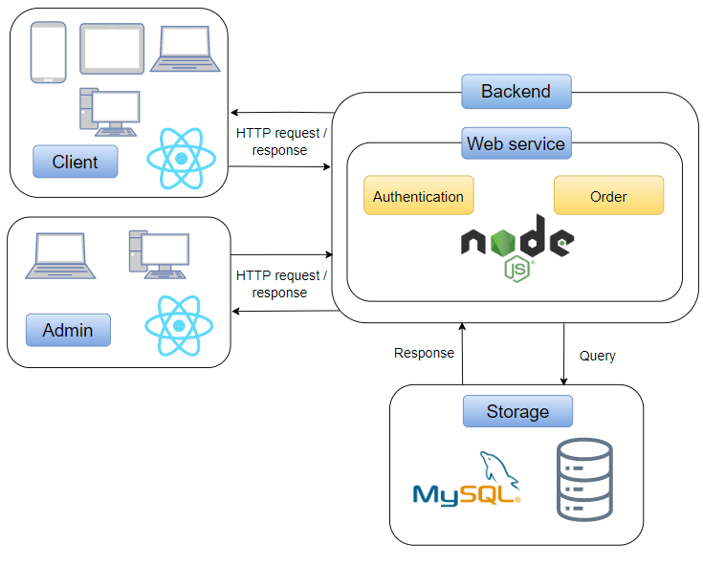
System Architecture Diagram

Slide 10
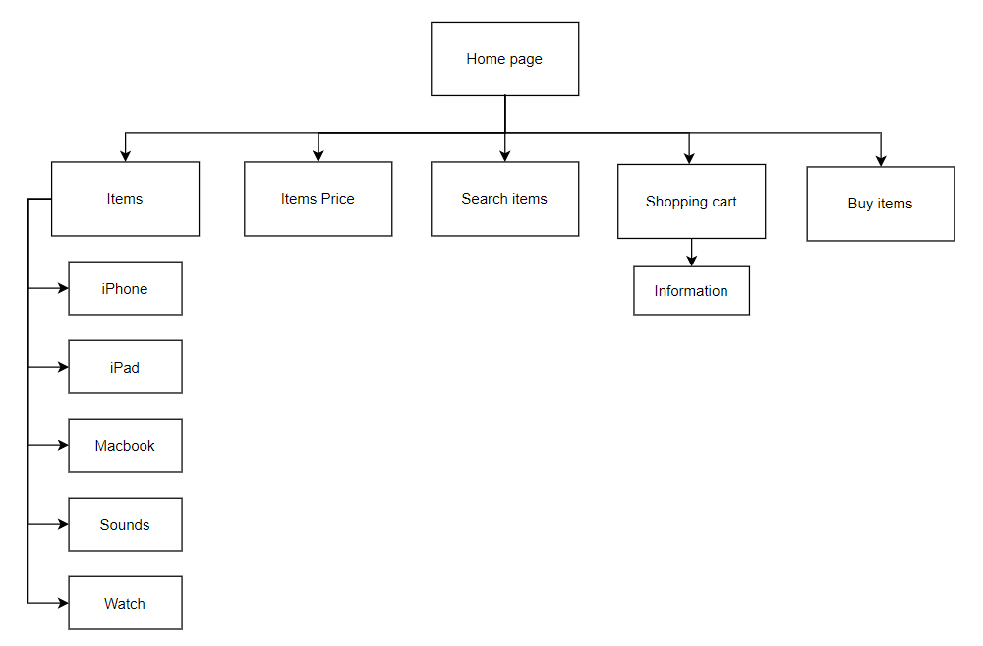
Website Architecture Diagram
PROJECT TIMELINE
PAGE NUMBER

Slide 11
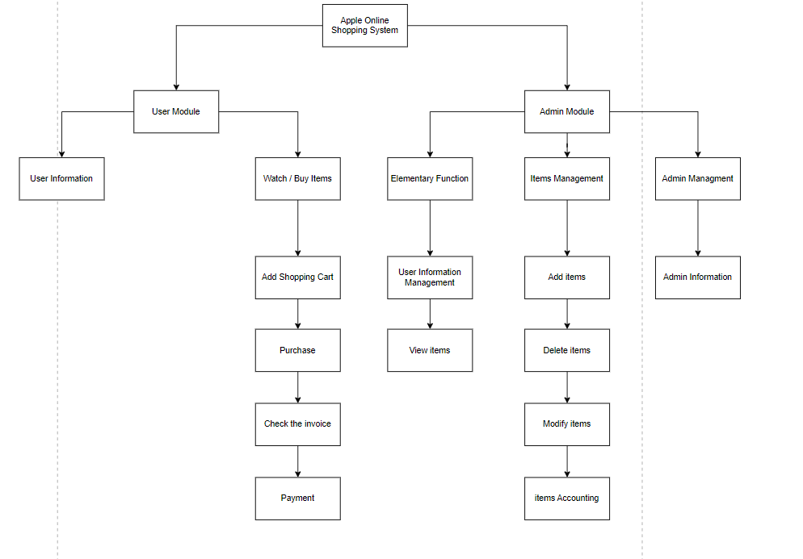
Website Functional Architecture Diagram
PROJECT TIMELINE
PAGE NUMBER

Slide 12

03
Database
PROJECT TIMELINE
Database
Database
PAGE NUMBER

Slide 13
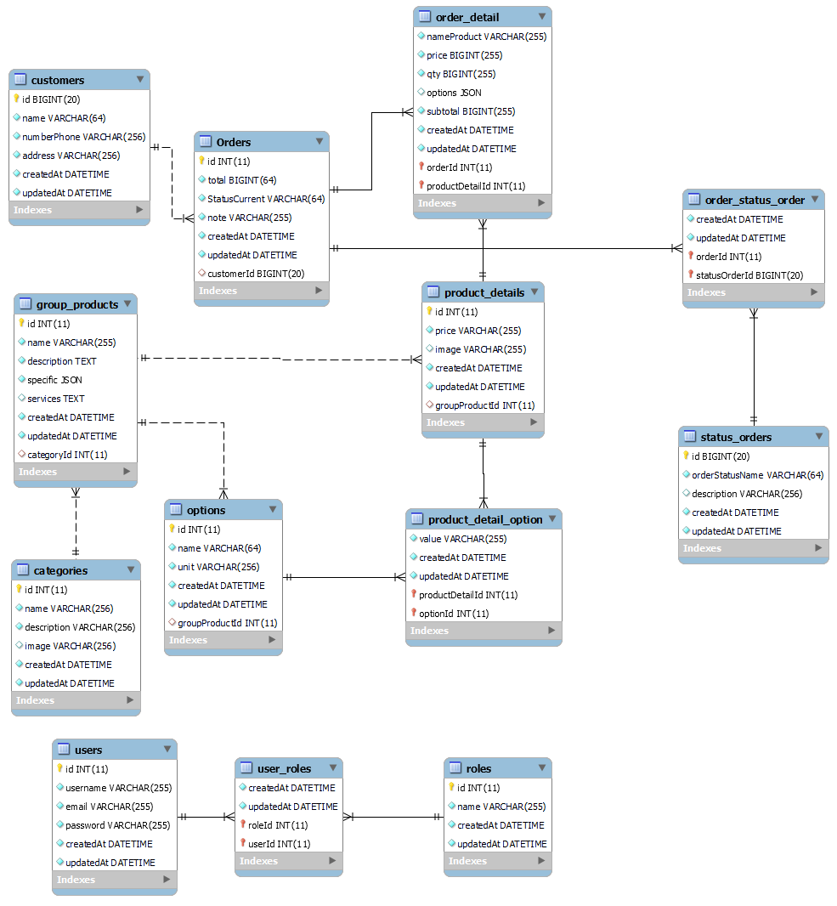
PROJECT TIMELINE
ERD
PAGE NUMBER

Slide 14
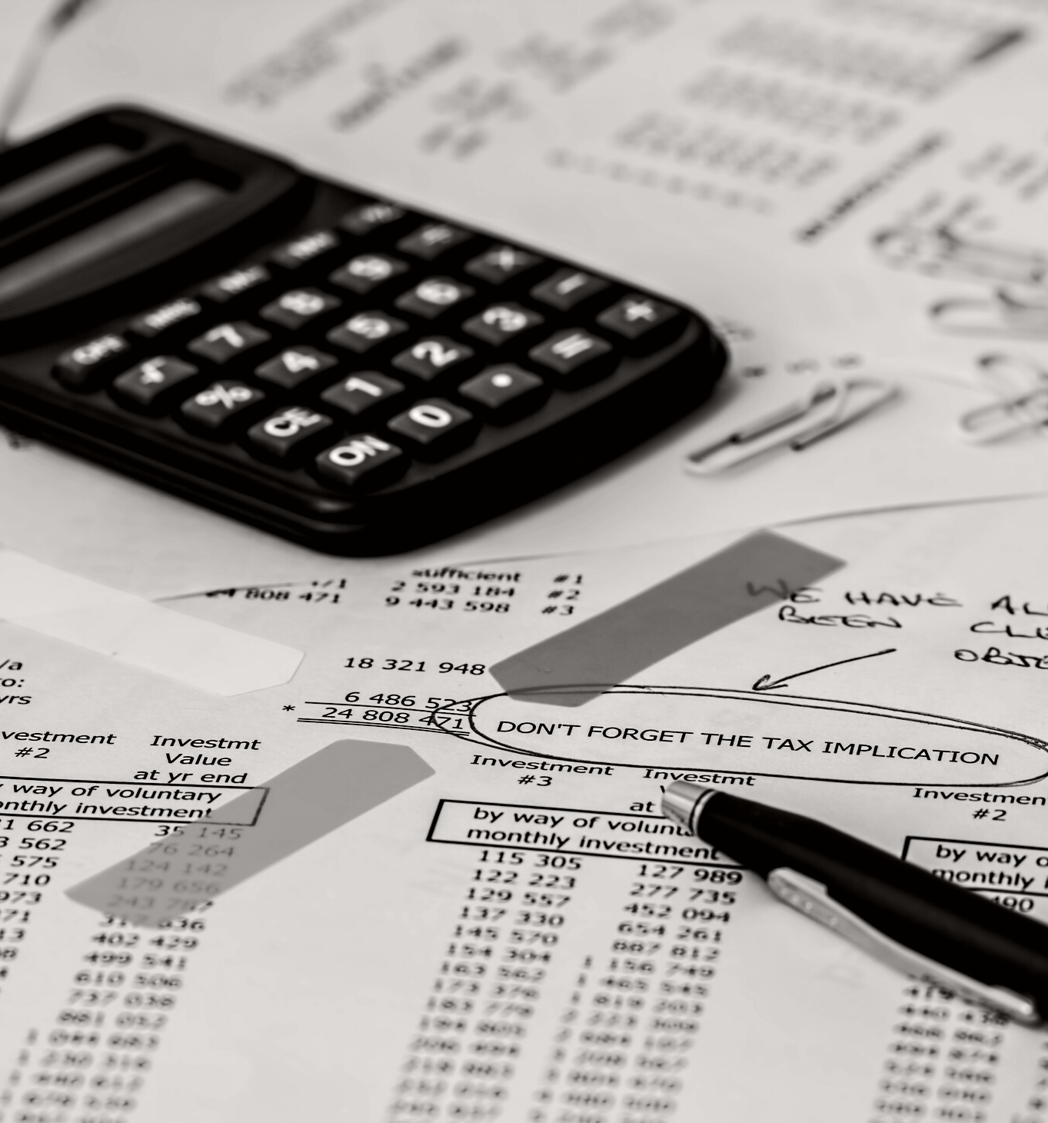
PROJECT TIMELINE
04
Demo
PAGE NUMBER

Slide 15


05
PROJECT TIMELINE
References
https://shopdunk.com/
https://github.com/bezkoder/node-js-express-login-example
https://www.youtube.com/playlist?list=PLJo1W2q6iqxnT0BTF5NKBu9vfdAb4Jrkz
https://github.com/bezkoder/react-js-login-registration-hooks
https://github.com/nishant-666/Dynamic-Forms
PAGE NUMBER

Slide 16
Thank you!
PROJECT TIMELINE
PAGE NUMBER
Write a closing statement or call-to-action here.

